Slide 1
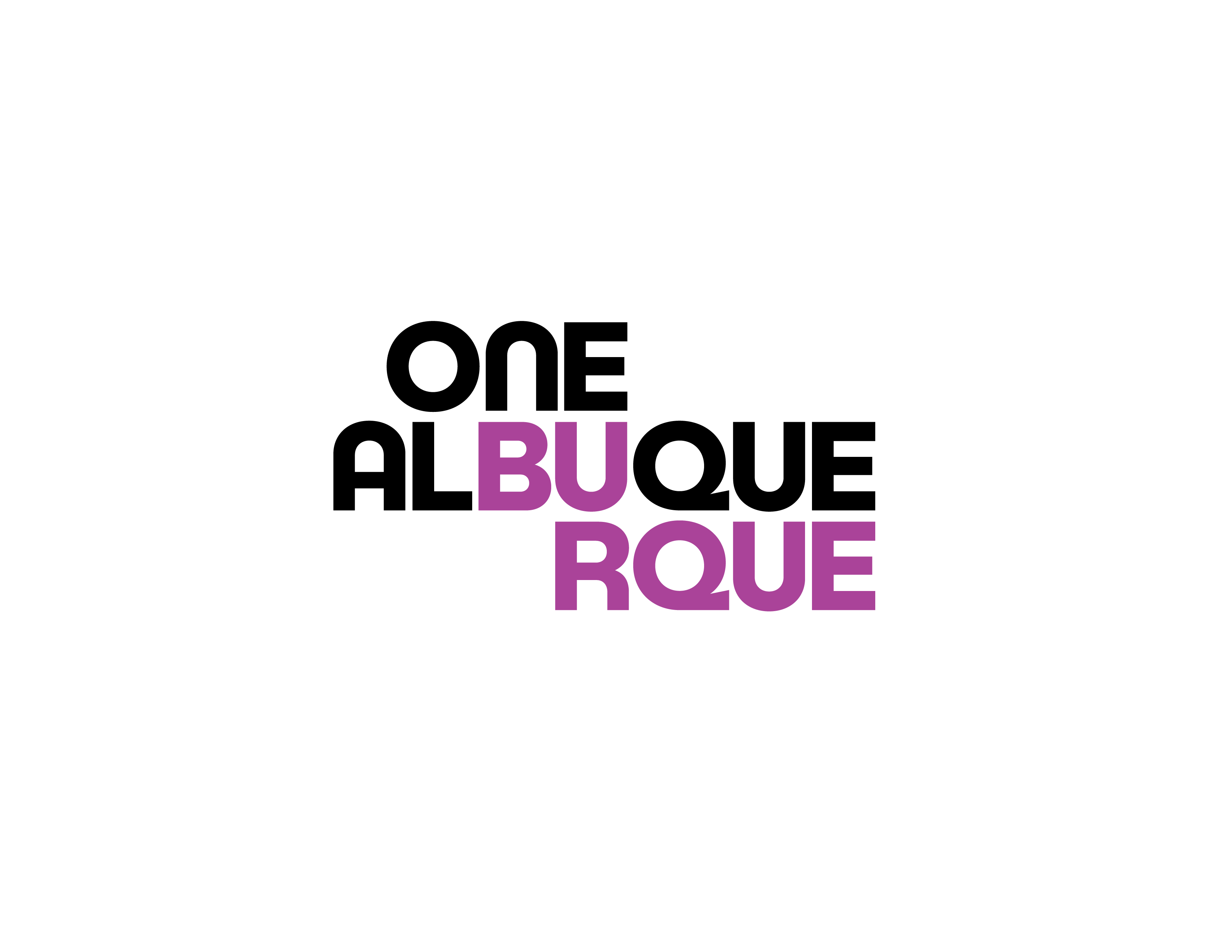
Smart Communities
What is the City of Albuquerque Doing?
How is it different to other Smart Cities?
How can we help?
PRESENTATION: Mark Leech
Department of Technology and Innovation| 03.22.2024
Notes:
Presentation Opener Slide

Slide 2
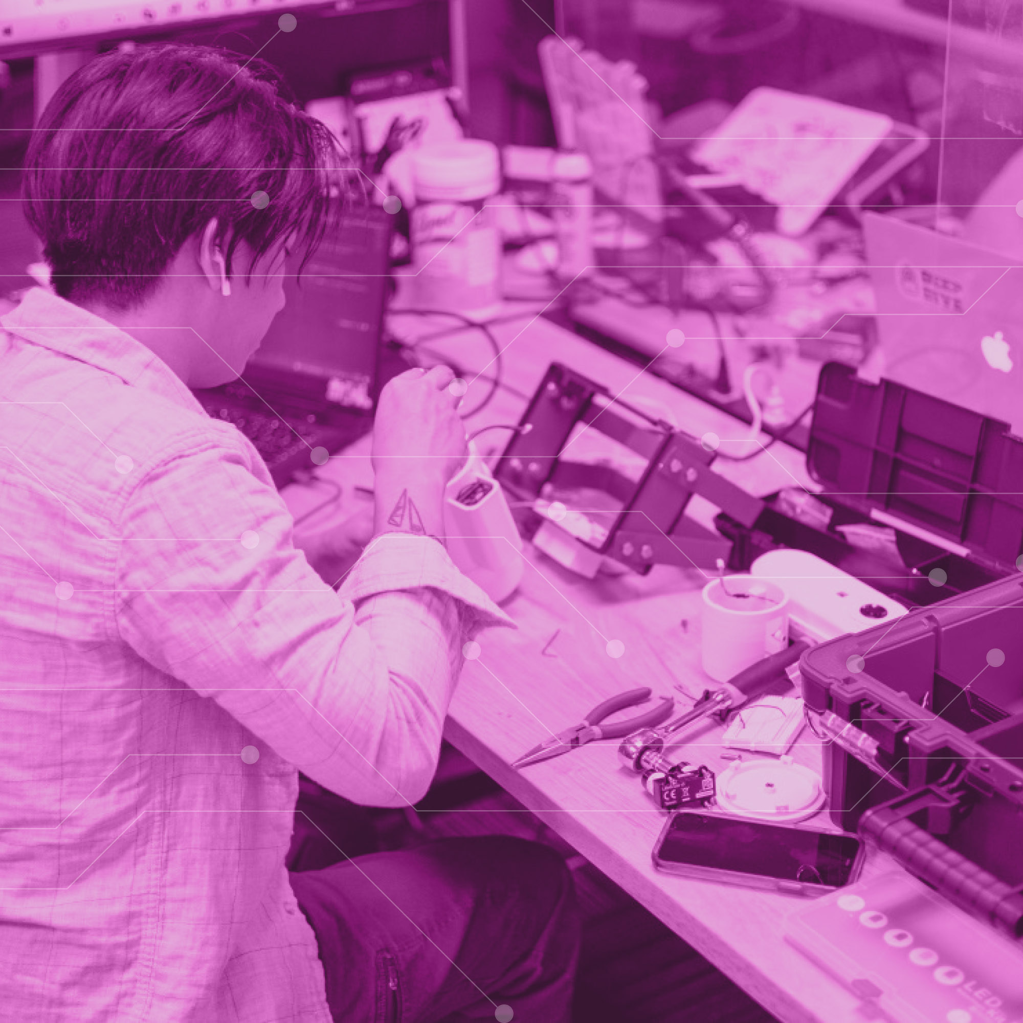
Value Proposition
There is no single “smart city” leader in the US.
What would it take for Albuquerque to be a recognized as a Smart Cities leader?
How can we train the next generation of smart workers?
How can Albuquerque set the standard for what it means to be a “Smart City”?
What does each of us bring to the potluck?
Department of Technology and Innovation| Smart Communities| 03.22.2024
Notes:
Basic Layout (right)

Slide 3
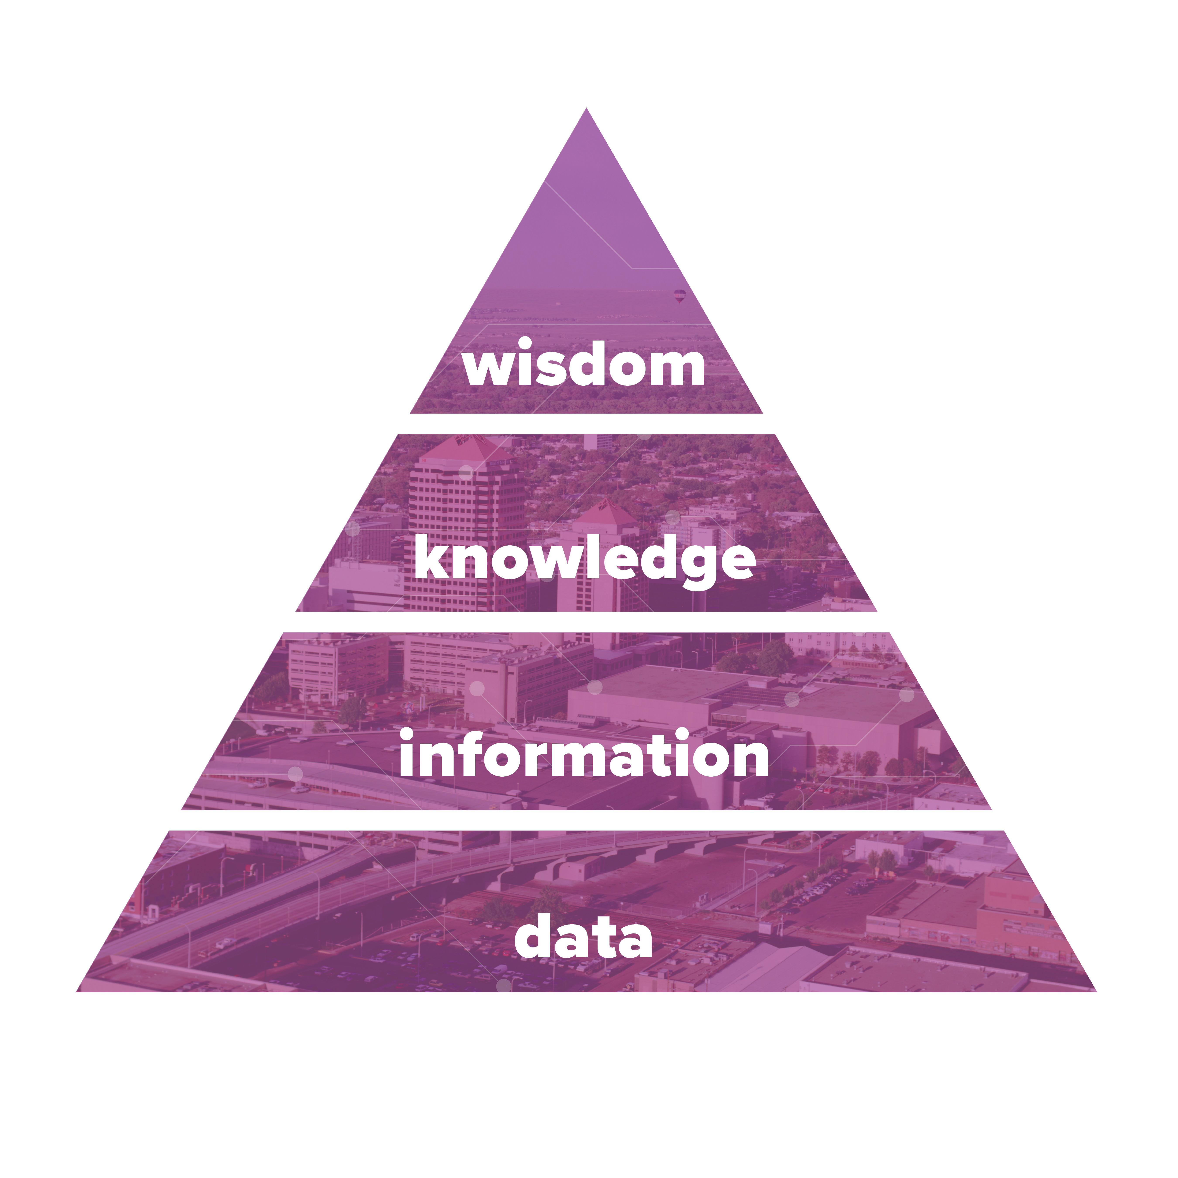
Data Framework
Acquisition
Curation
Federation
Department of Technology and Innovation| Smart Communities| 03.22.2024
Notes:
Global smart cities market is estimated t 1024.4 billion (https://www.marketsandmarkets.com/Market-Reports/smart-cities-market-542.html)

Slide 4
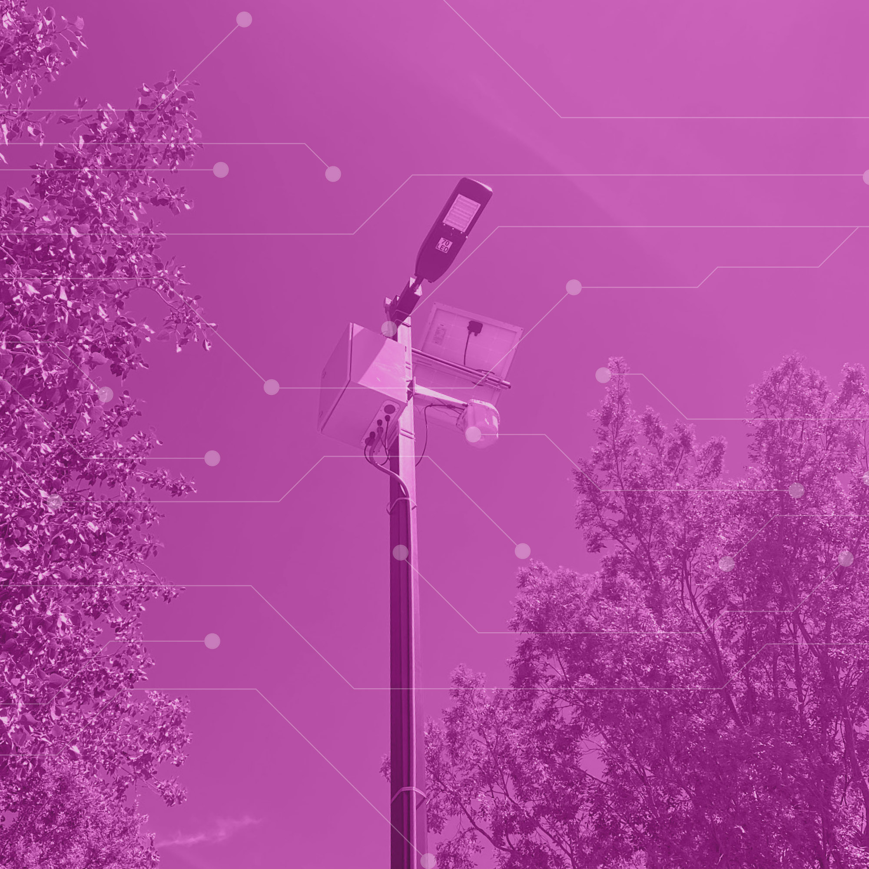
What Makes a City “Smart”?
Sensors that acquire data from the community
Data that is collected and used
Information that can be gleaned from the data
Decisions that can be made (AI and ML) from the information
People who are curious about our community
(“Smart Buildings” are out of the discussion for today!)
Department of Technology and Innovation| Smart Communities| 03.22.2024
Notes:
Global smart cities market is estimated t 1024.4 billion (https://www.marketsandmarkets.com/Market-Reports/smart-cities-market-542.html)

Slide 5
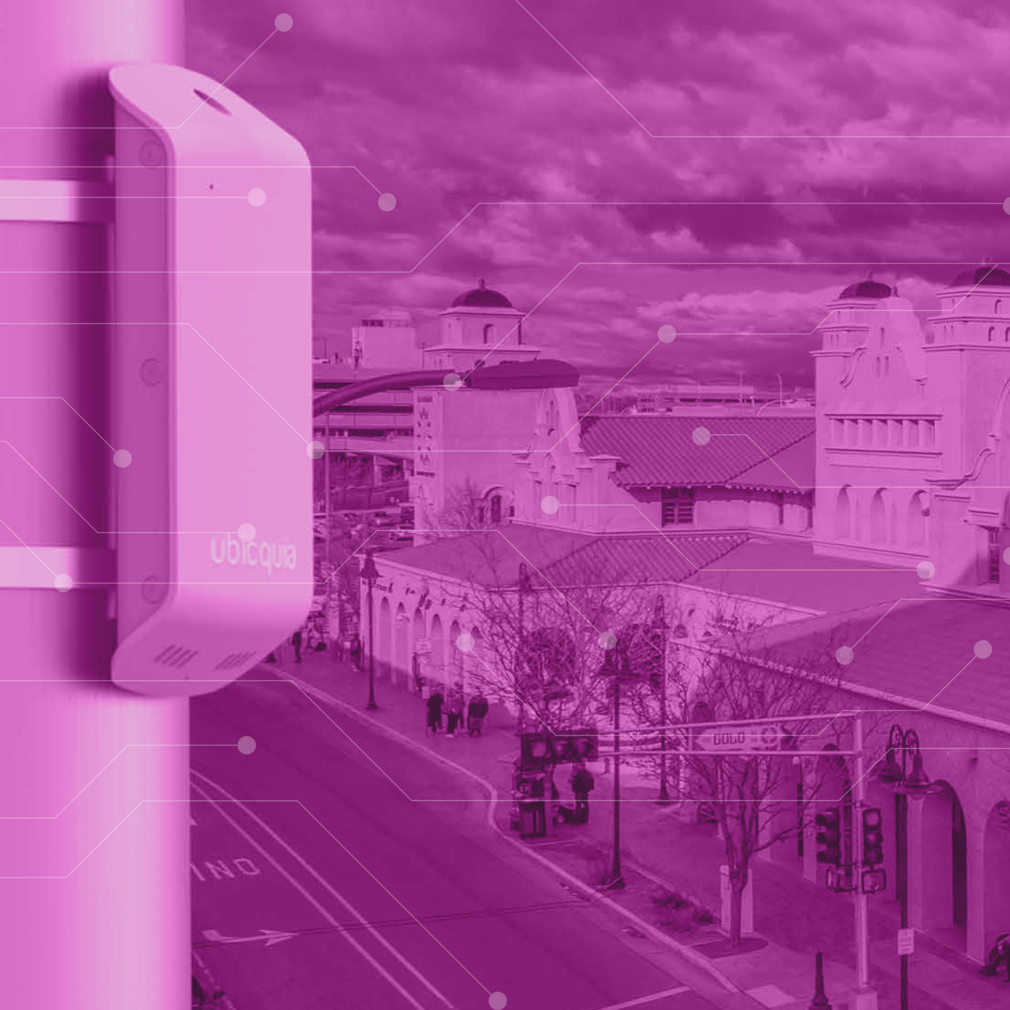
Smart Communities
Not always “new” solutions
Community-specific to Albuquerque
Start with the problem – not the technology
Working with education
Exportable skills and technology
Multi-faceted:
Broadband accessibility
Public safety
Public wifi
Enabling economic growth
Department of Technology and Innovation| Smart Communities| 03.22.2024

Slide 6
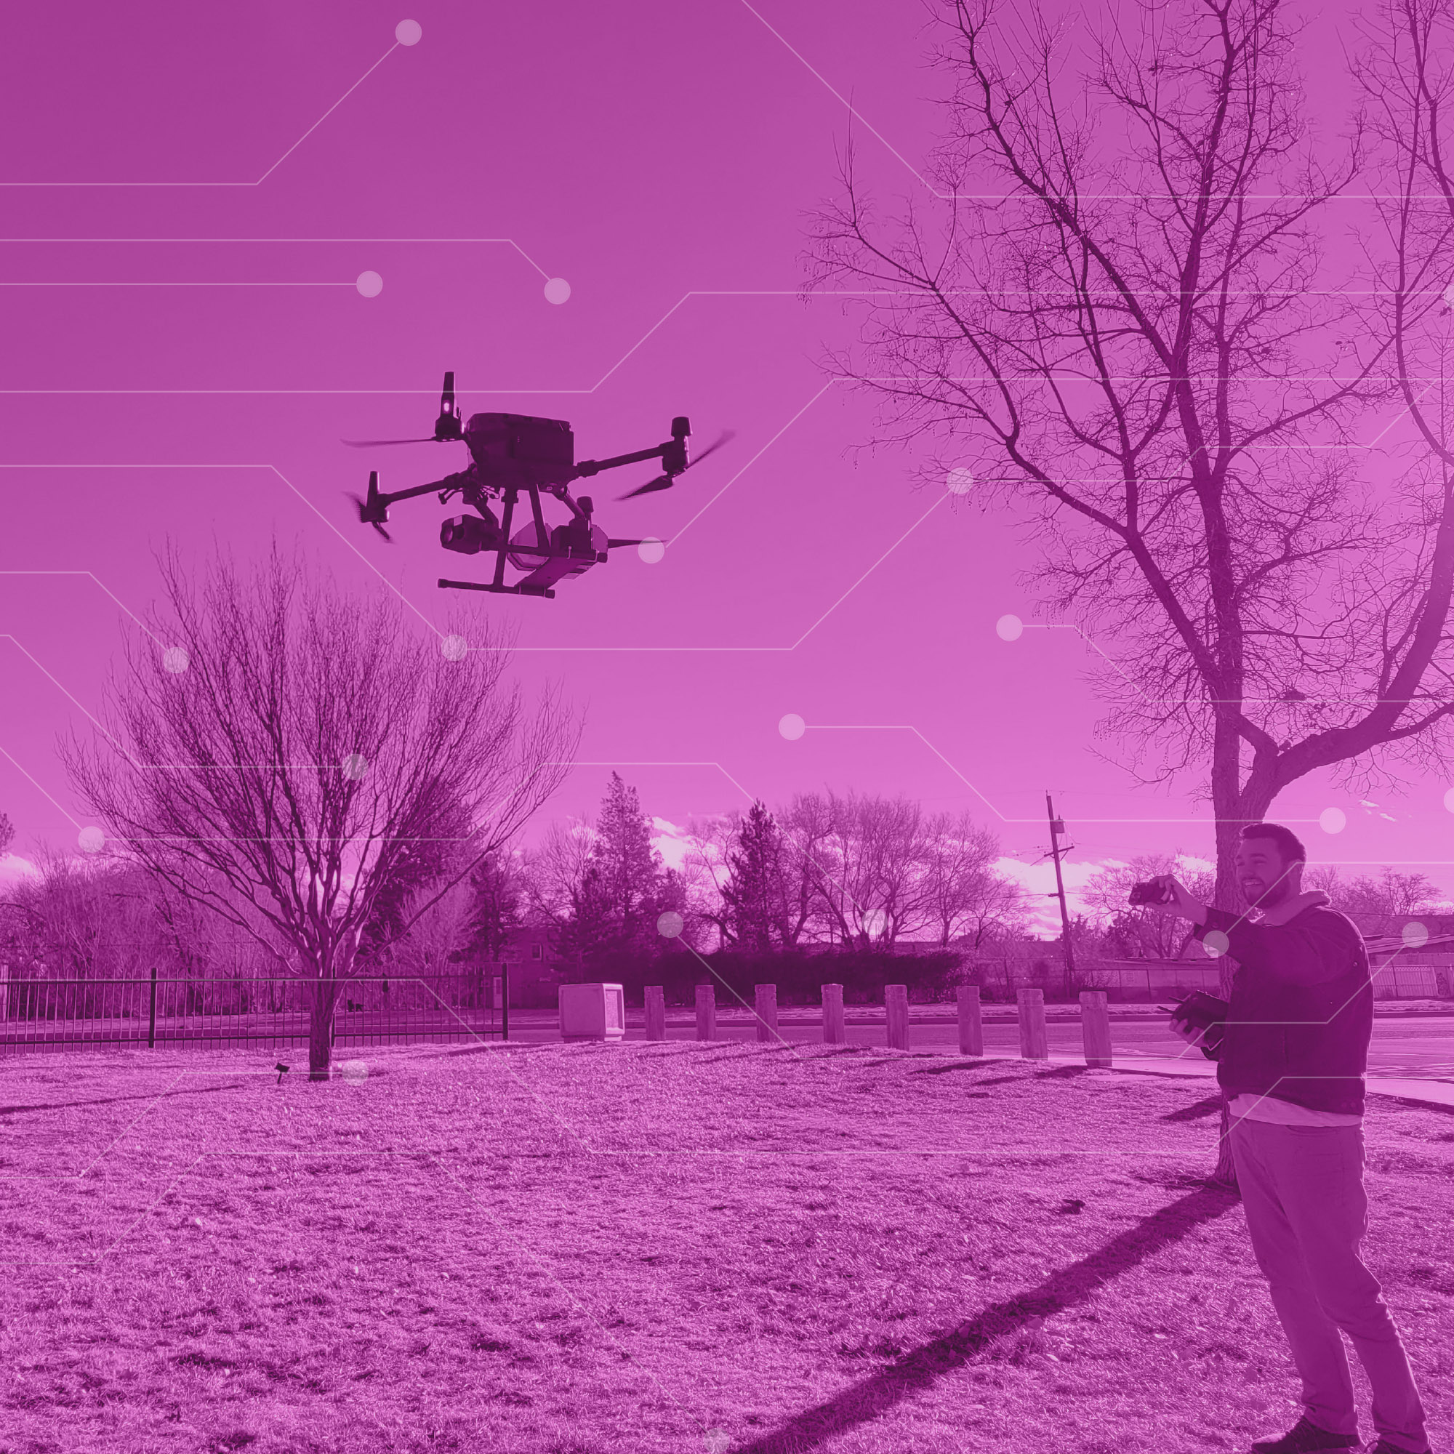
What is the City doing?
Increasing connectivity
Smart lighting
Smart parking
Bus shelters
Audio detection
Drone usage
Increased broadband competition
Tiguex Park
Department of Technology and Innovation| Smart Communities| 03.22.2024

Slide 7
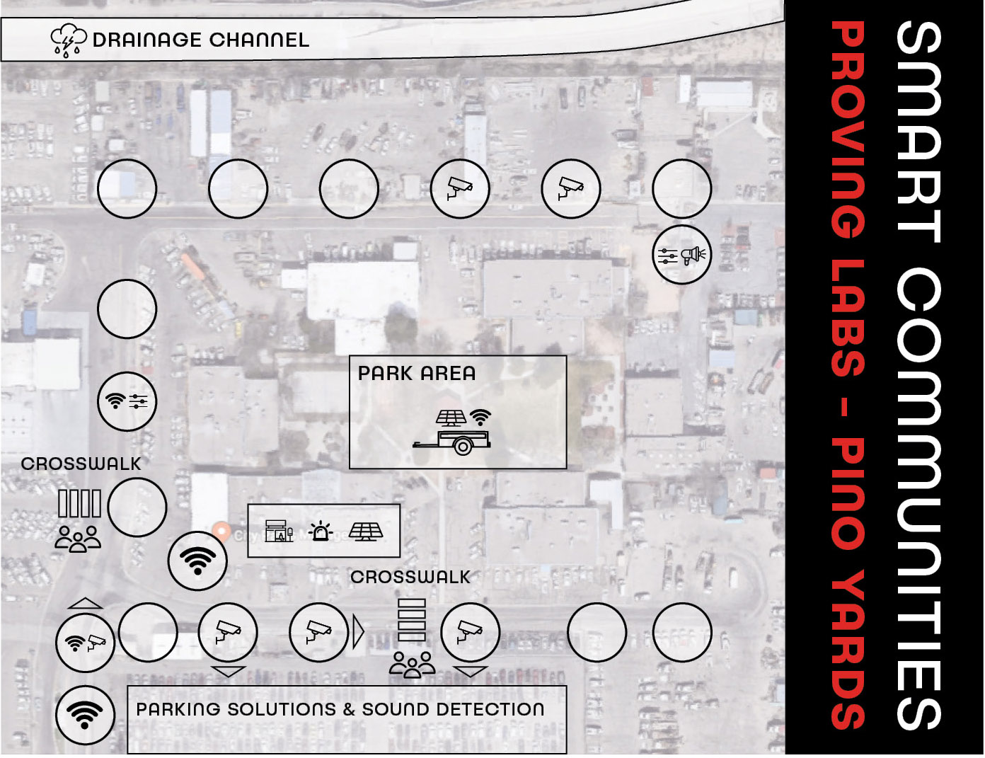
Pino Yards Proving Lab
Analog of Albuquerque
“Safe zone”
Learning opportunities (e.g. seasonal variation)
Cost estimation
Vendor agnostic
Education opportunities
Department of Technology and Innovation| Smart Communities| 03.22.2024

Slide 8
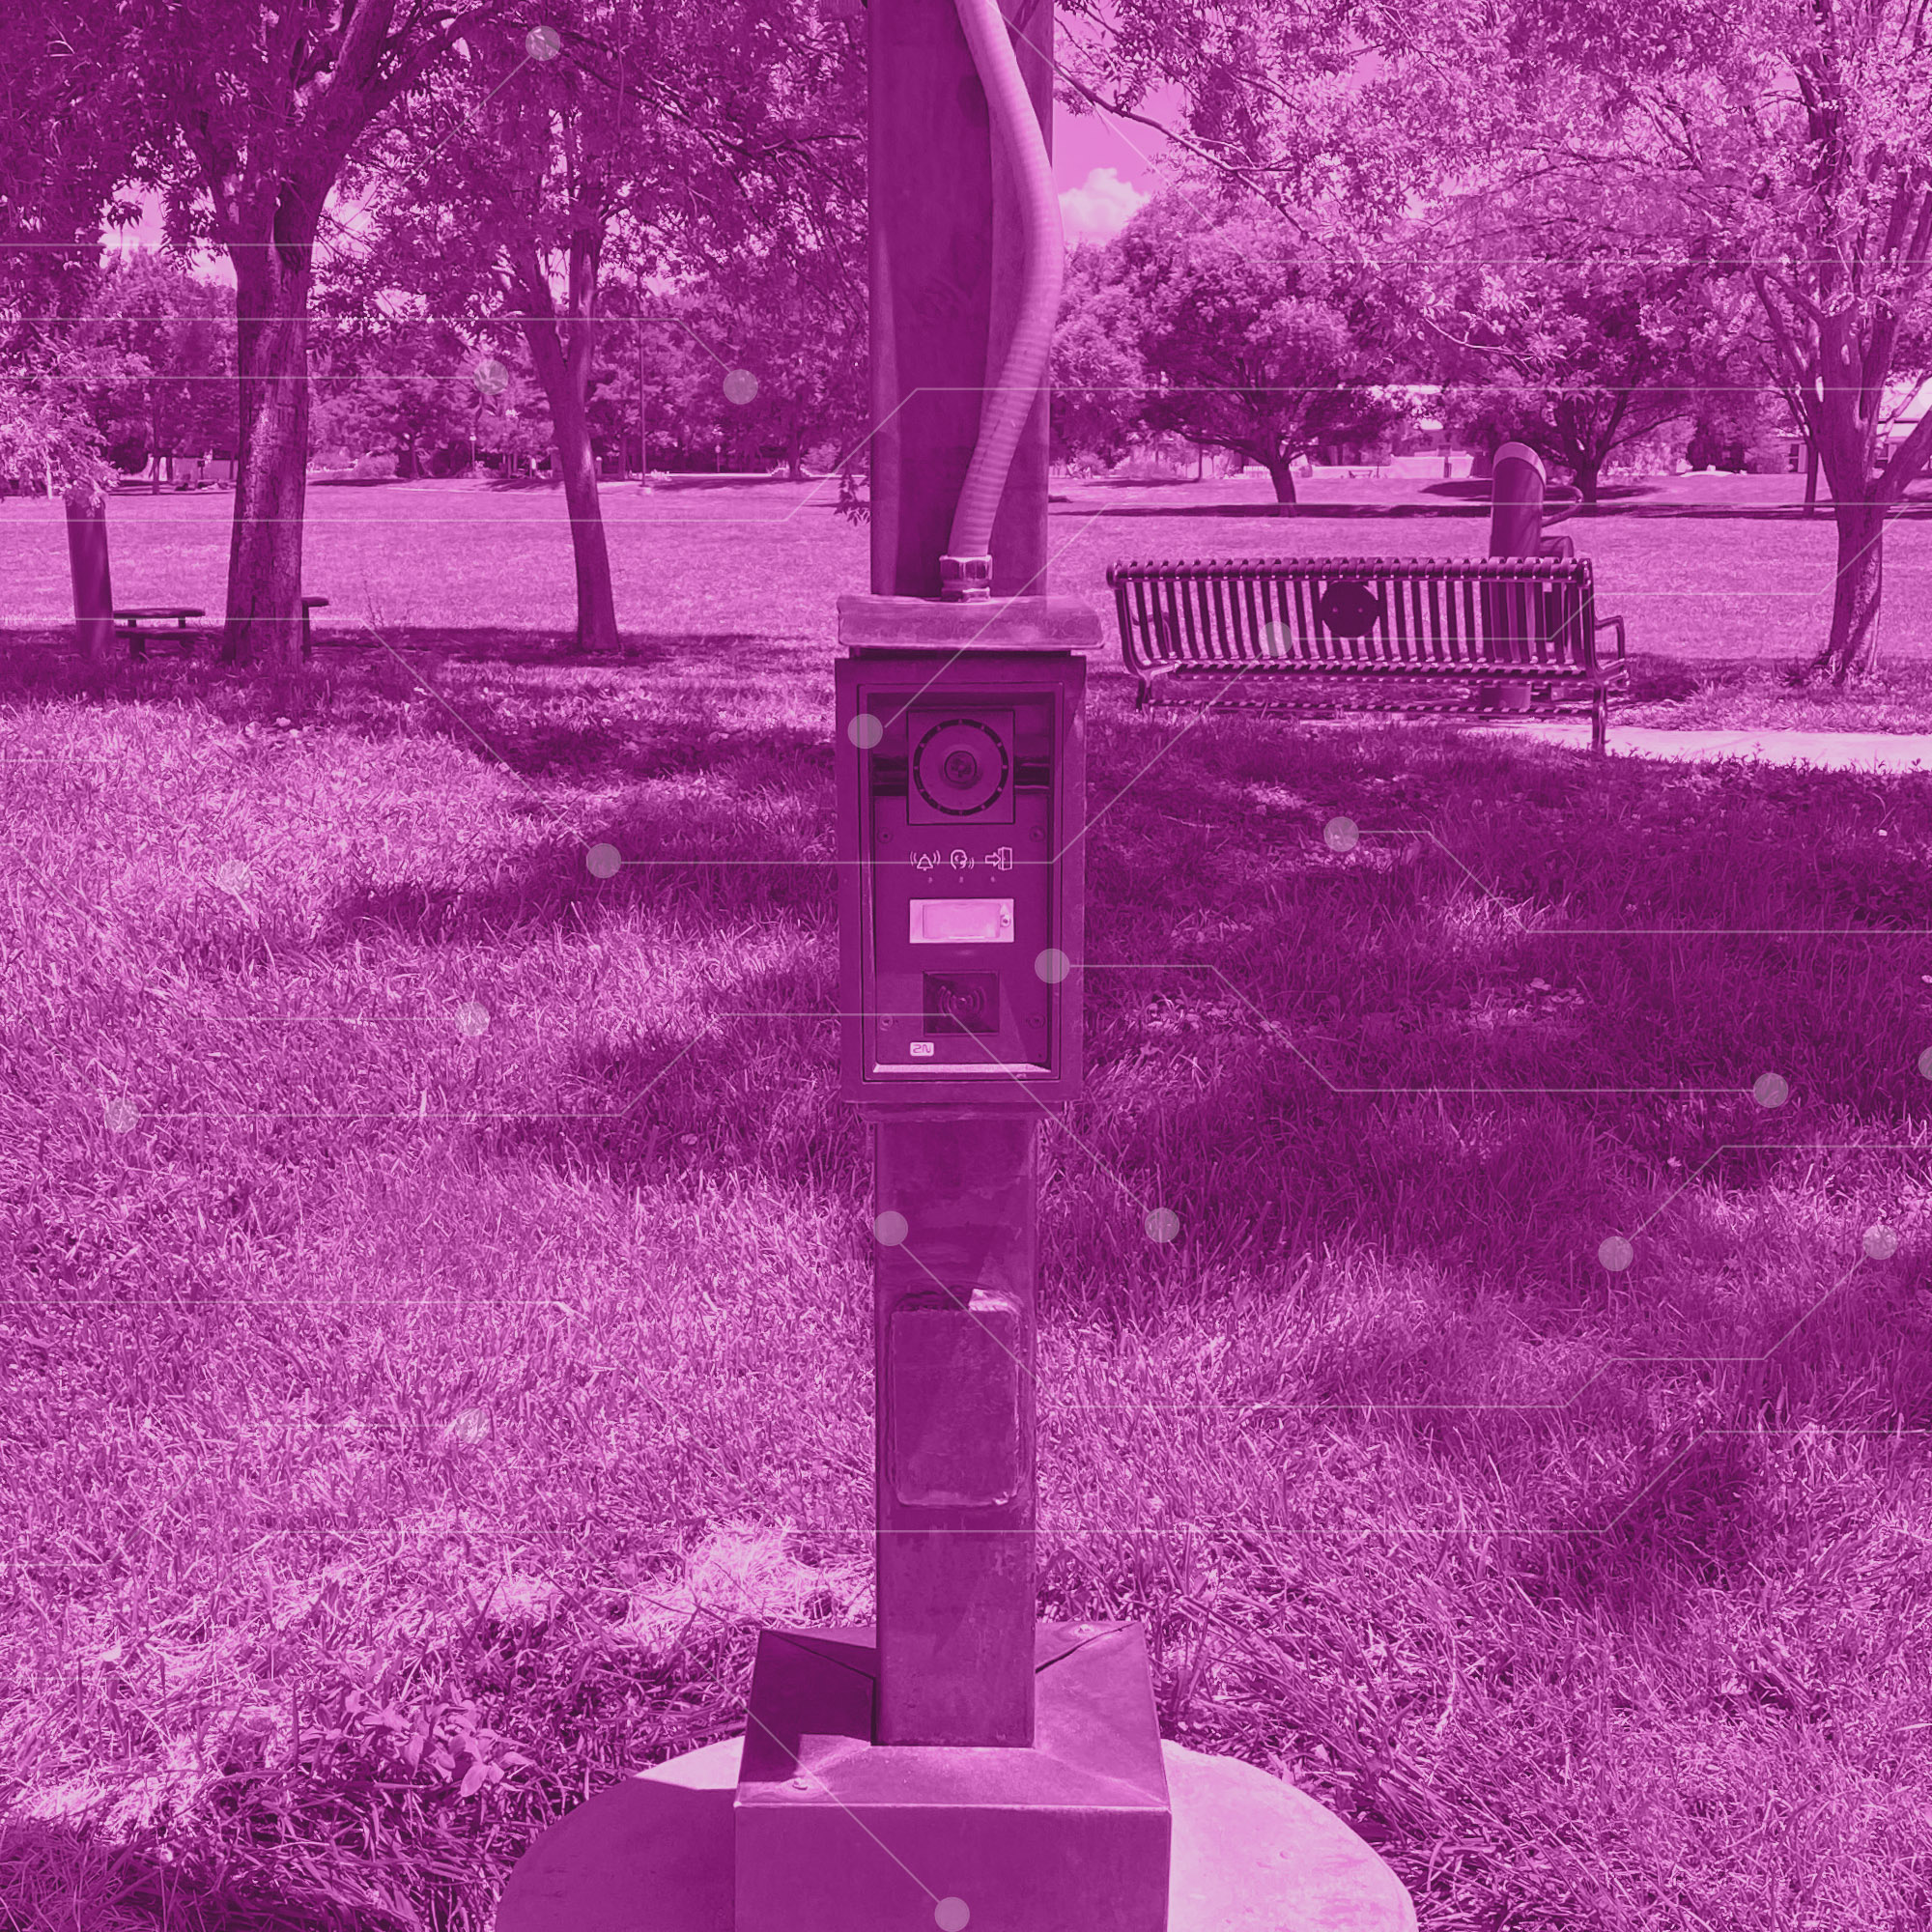
Opportunities for Collaboration
More “smart” ideas
Planning for tomorrow’s workforce
AI and ML
Understanding the ethical framework
Pino Yards and Rainforest collaboration
Central Fiber Technology Showcase
Department of Technology and Innovation| Smart Communities| 03.22.2024

Slide 9
Questions
Mark Leech mleech@cabq.gov
Department of Technology and Innovation| Smart Communities| 03.22.2024

